Slide 1

The Variables to Success
Che Guan, Judge Hiciano, Nicholas Lee, Tatianna Martinez
School of Information, University of California Berkeley
W200, Introduction to Data Science Programming
Thursday 630pm, Spring 2022, Tracy Huang

Slide 2

Research Questions
Do students have higher earnings if their degree program was one of the top five degree programs for 2019?
What top ten features are important in predicting higher earnings for students post graduation for 2019?
Notes:
For this project we used data from the College Scorecard site.
The college scorecard site was created for prospective students to compare the cost and value of higher education in the U.S.
The data was collected through a series of surveys ran annually from 1996 - 2020 by the department of education
After our EDA process we were able to come up with two questions that we wanted to answer:
Read Question 1
For this question, we used a correlation matrix to see if the top five program had any correlation to the students who had higher earnings post graduation
Read Question 2
We built a predictive model that told us the most important features for students who had higher earnings post graduations

Slide 3

Data Cleansing
24 CSV files from school years 1997 - 2020
Transformation:
(170026, 2990) -> (48477, 175)
From certificate to Graduate degrees
Notes:
Here is a slide of some quick facts about our data cleaning process
For data cleansing we used python and Tableau prep
Tableau prep was easier for
recoding values
Categorical variables coded as 0,1,2
renaming columns
One of the most challenging factors of this project was identifying our scope for our research questions because
There were a lot of null rows and columns and redacted information for data privacy
Some initial analysis we wanted to do was specific to individual students, but the data wasn’t structured that way
Data was structured in a way where the primary key was at institution level
Next Nicholas is going to speak a little bit more about data limitations
Because many of the columns were added later on during collection, they remain empty for many of the pervious years.
Adding end year to each file and mering csv files to
Kept features of the institution and entering class related to enrollment numbers, percentage of degrees awarded by degree type.
Data dictionary was helpful for reducing the columns. The most helpful part of this dataset was the data dictionary that was provide with the set. This allowed us to recode the information in columns to categorical but coded as numeric. For example the type of institution was encoded as 0: Public, 1: Private Non-Profit, 2: Private For-Profit.
Degrees varied from certificate programs that were from technical schools like barber and beauty schools, plumbing and electrical technicians. To focus the scope of the dataset we decided to focus on institutions that predominately awarded bachelor degrees.
The highest degree for an institution could have been used, but then it would have included programs such as community colleges that have a few bachelors but majority of their degrees are from associates.
Family income columns and percentage taken to complete the program, 100% / 150% / 200% percent of the time were excluded
Privacy Supressed
Image: https://blog.digitalj2.com/importing-clean-data-into-a-crm

Slide 4
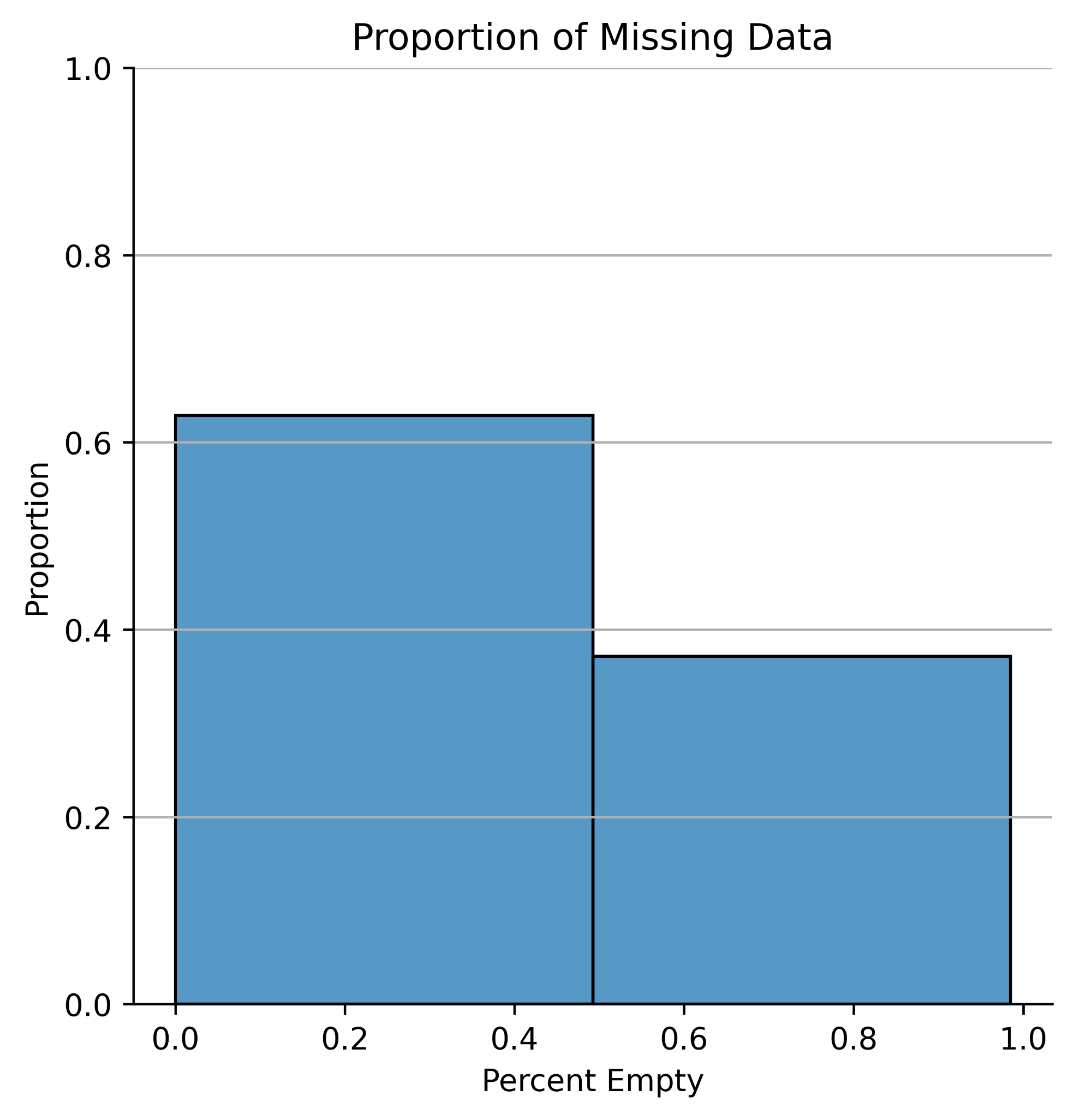
Limitations
~40% of the columns have more than half of the data missing.
Privacy Suppressed
Notes:
Because many of the columns were added later on during collection, they remain empty for many of the pervious years.
Adding end year to each file and mering csv files to
Kept features of the institution and entering class related to enrollment numbers, percentage of degrees awarded by degree type.
Data dictionary was helpful for reducing the columns. The most helpful part of this dataset was the data dictionary that was provide with the set. This allowed us to recode the information in columns to categorical but coded as numeric. For example the type of institution was encoded as 0: Public, 1: Private Non-Profit, 2: Private For-Profit.
Degrees varied from certificate programs that were from technical schools like barber and beauty schools, plumbing and electrical technicians. To focus the scope of the dataset we decided to focus on institutions that predominately awarded bachelor degrees.
The highest degree for an institution could have been used, but then it would have included programs such as community colleges that have a few bachelors but majority of their degrees are from associates.
Family income columns and percentage taken to complete the program, 100% / 150% / 200% percent of the time were excluded
Privacy Supressed
Image: https://blog.digitalj2.com/importing-clean-data-into-a-crm

Slide 5
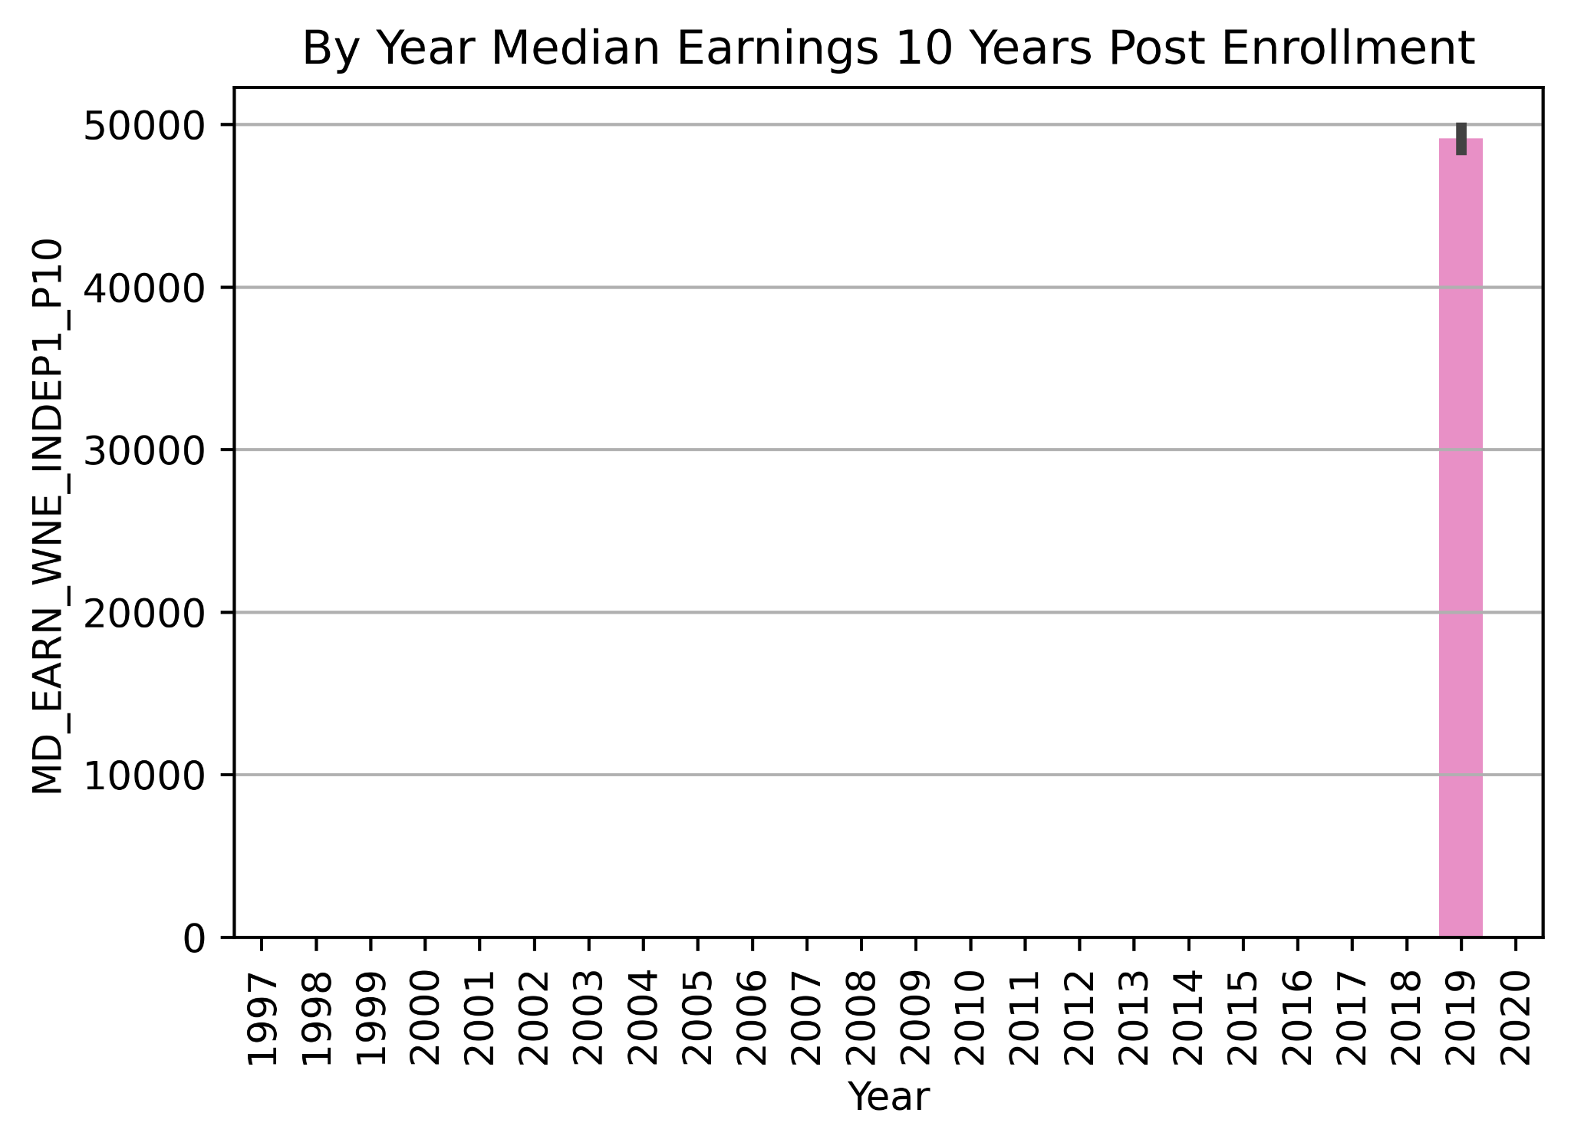
Limitations
Variables added as years passed
Median earnings of independent students working and not enrolled 10 years after entry (MD_EARN_WNE_INDEP1_P10)
Notes:
Because many of the columns were added later on during collection, they remain empty for many of the pervious years.
Adding end year to each file and mering csv files to
Kept features of the institution and entering class related to enrollment numbers, percentage of degrees awarded by degree type.
Data dictionary was helpful for reducing the columns. The most helpful part of this dataset was the data dictionary that was provide with the set. This allowed us to recode the information in columns to categorical but coded as numeric. For example the type of institution was encoded as 0: Public, 1: Private Non-Profit, 2: Private For-Profit.
Degrees varied from certificate programs that were from technical schools like barber and beauty schools, plumbing and electrical technicians. To focus the scope of the dataset we decided to focus on institutions that predominately awarded bachelor degrees.
The highest degree for an institution could have been used, but then it would have included programs such as community colleges that have a few bachelors but majority of their degrees are from associates.
Family income columns and percentage taken to complete the program, 100% / 150% / 200% percent of the time were excluded
Privacy Supressed
Image: https://blog.digitalj2.com/importing-clean-data-into-a-crm

Slide 6
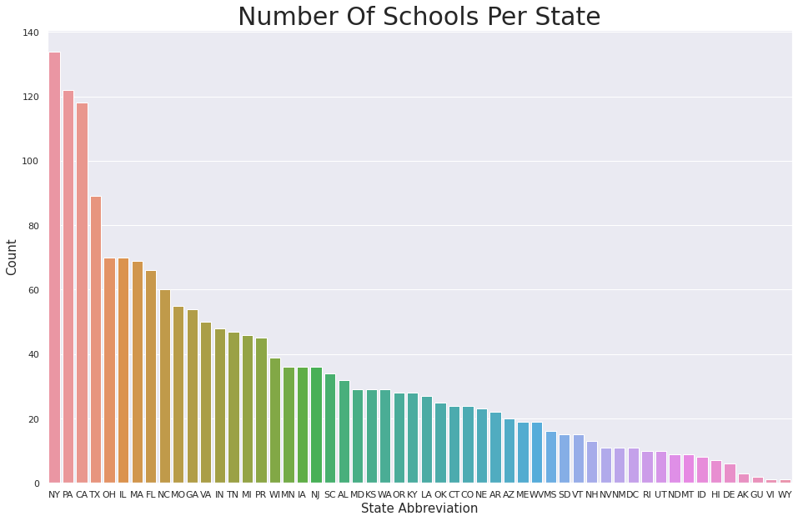
Exploratory Data Analysis
Dataset consist of self reported information from 2,780 universities and colleges around the United States from 1997-2020
The dataset does include US territories: Puerto Rico, Guam, and the Virgin islands which we left in the data set.
The dataset itself has evolved over time but has never dropped any columns, so there were many columns that had Null values.
Based on the question we are exploring, there were only 71 entries that had null values for the columns that we identified we needed to investigate our question.
Notes:
Ever evolving data set. The original data included a wide range of school which included universities, community colleges, trade, and technical schools. We filtered down on schools whose primary degree offered was a bachelors degrees. This left is with a total 2,780 schools which included schools from US territories.

Slide 7
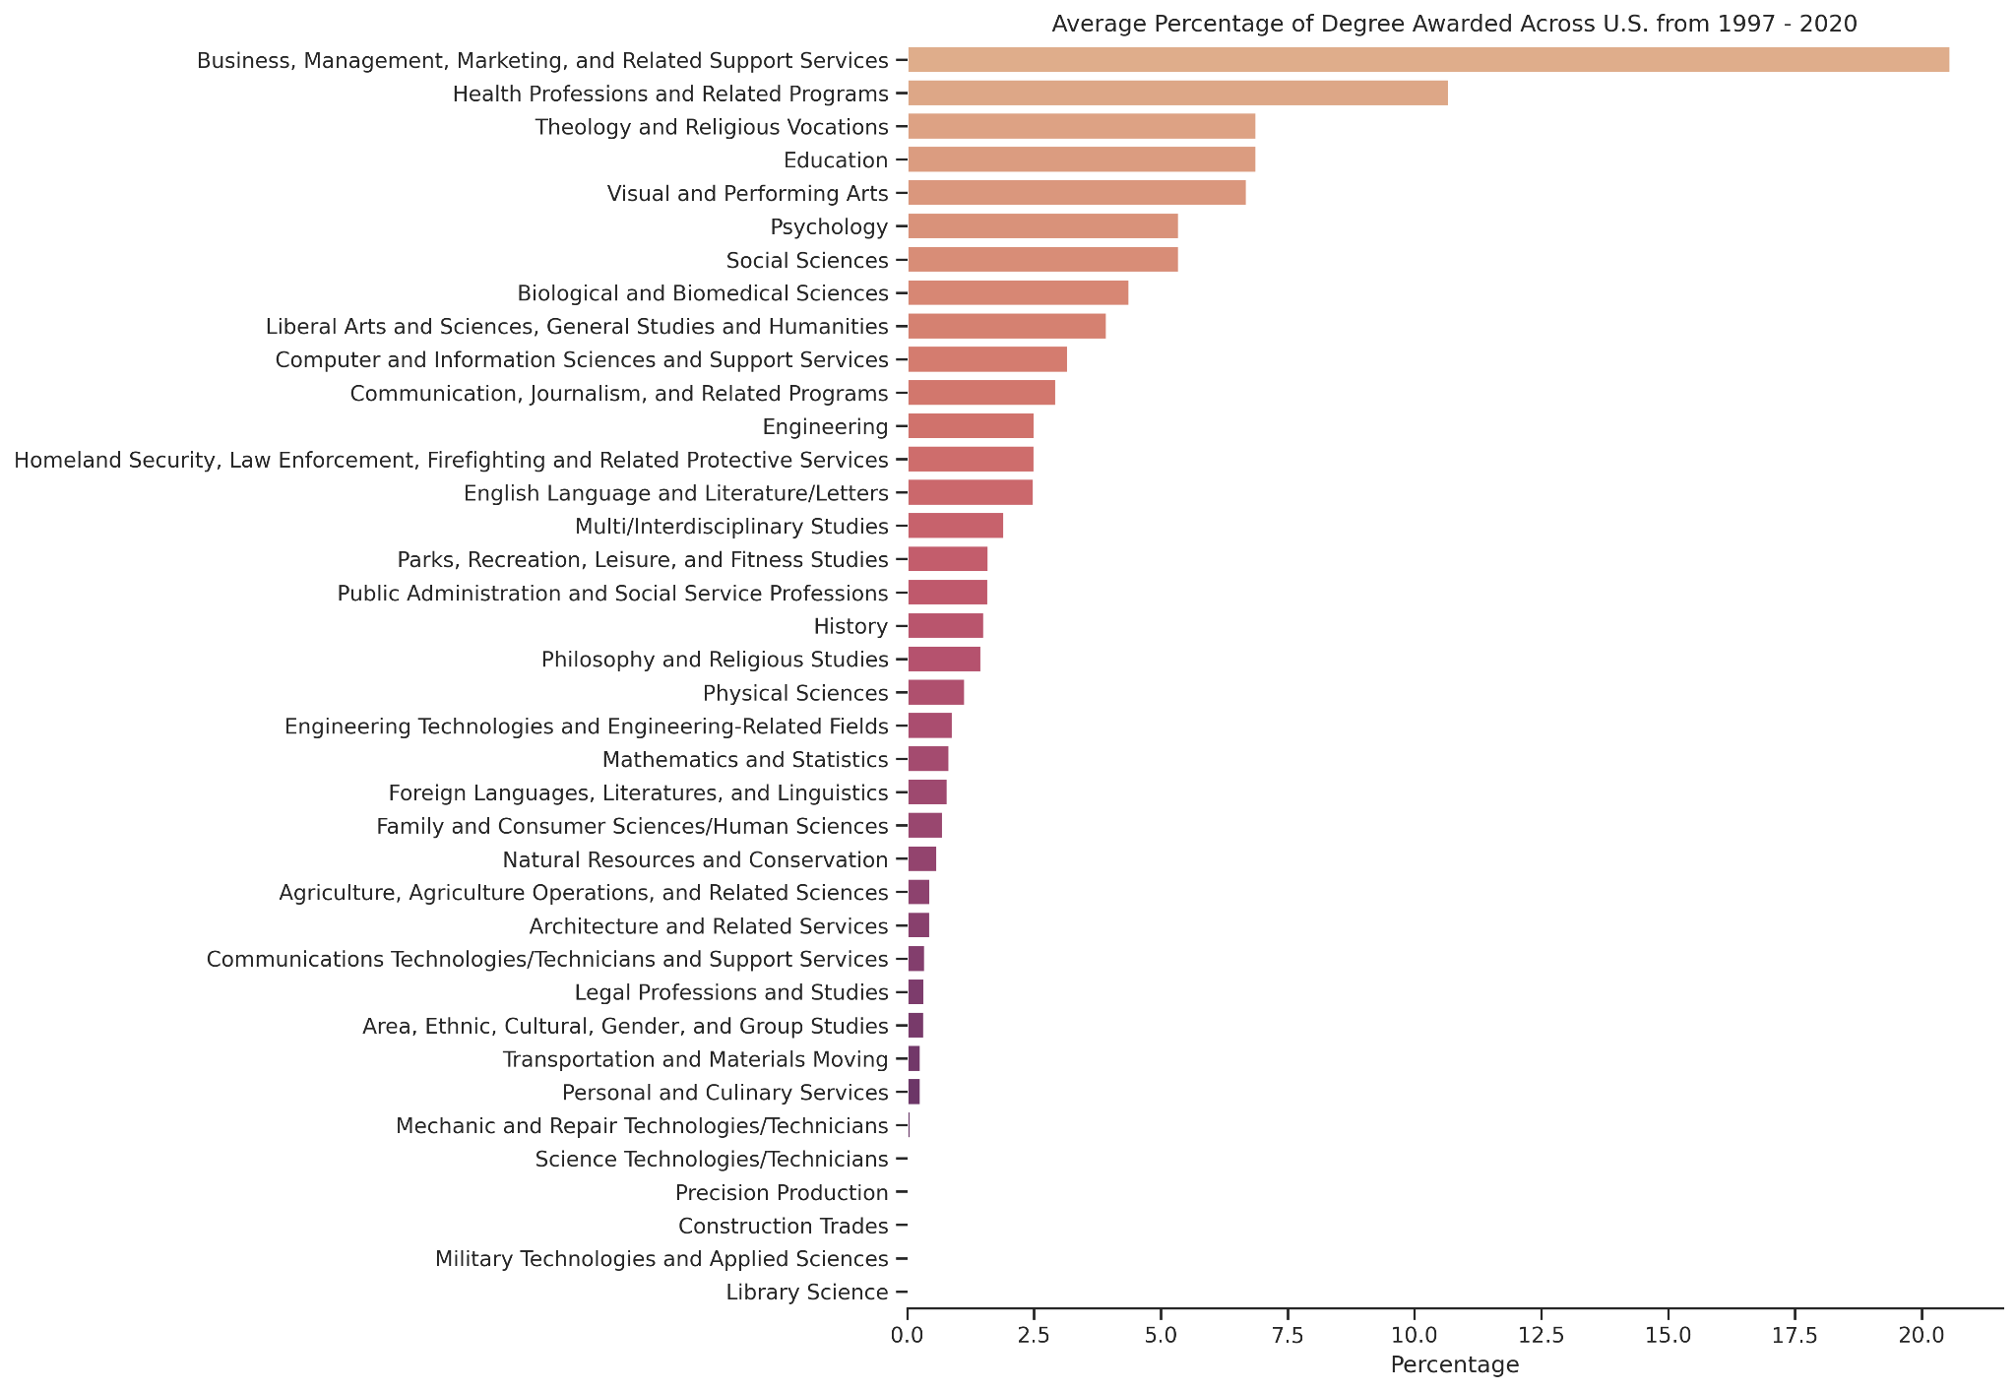
Exploratory Data Analysis
Notes:
Filtering out the degrees that had < 1% of that degree awarded because that hid the distributions for the degrees that stood out
The proportion of percent that degree awarded. The two degrees that stand out to be > 10% awarded are Business, management, Marketing and related support and Health Professions and related Programs.
Helped to identify which degrees were awarded more than others.

Slide 8
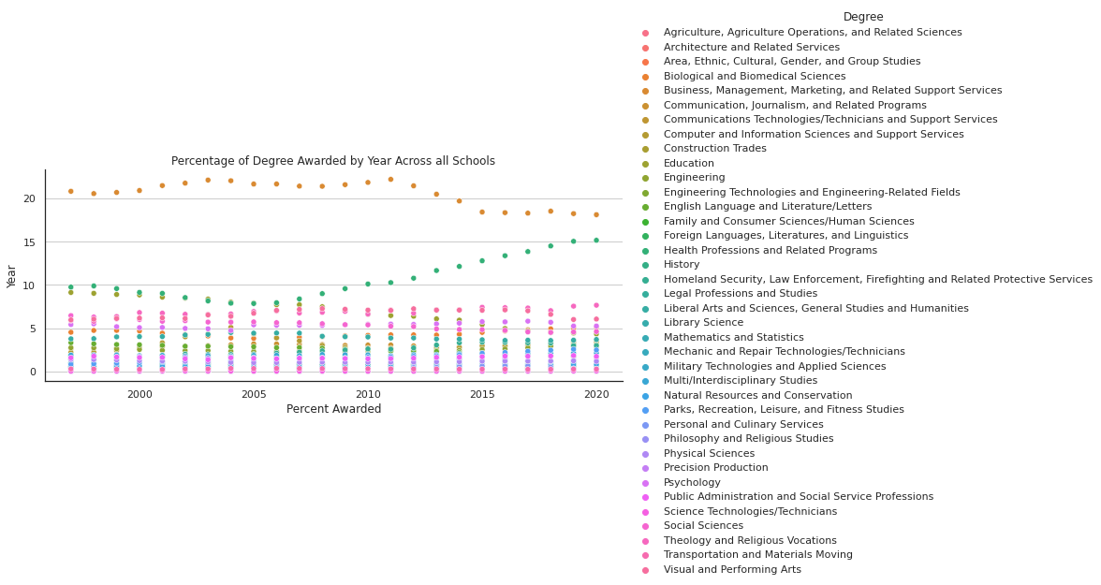
Exploratory Data Analysis
Notes:
Filtering out the degrees that had < 1% of that degree awarded because that hid the distributions for the degrees that stood out
So now we filtered out the data just to the the features relevant to our initial questions and filter out for 2019 years only and created a correlation matrix to look for any relationships between median income and the program a student is enrolled.

Slide 9
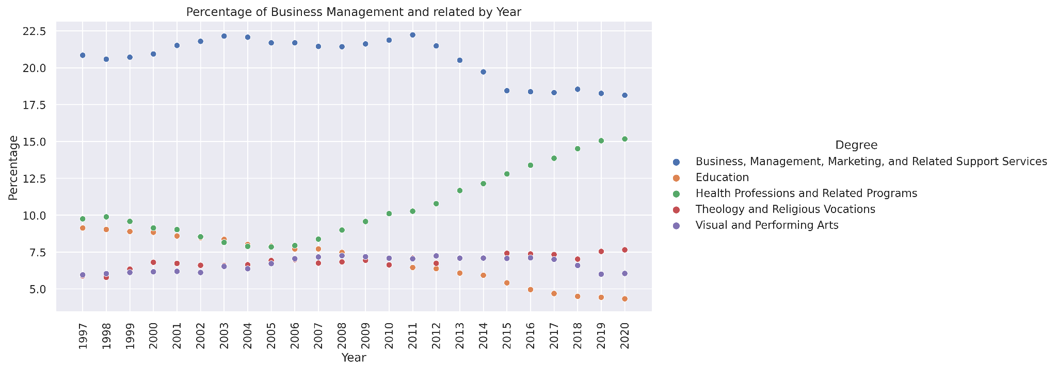
Exploratory Data Analysis
Notes:
Drop in business degrees by 4 percent from 2011 to 2015.
Increase in Health Professions degrees starting in 2006.
Overall decrease in education degrees awarded.
Slight increase in theology and visual arts degrees awarded
2065 Private / 667 Public Schools
So now we filtered out the data just to the the features relevant to our initial questions and filter out for 2019 years only and created a correlation matrix to look for any relationships between median income and the program a student is enrolled.

Slide 10
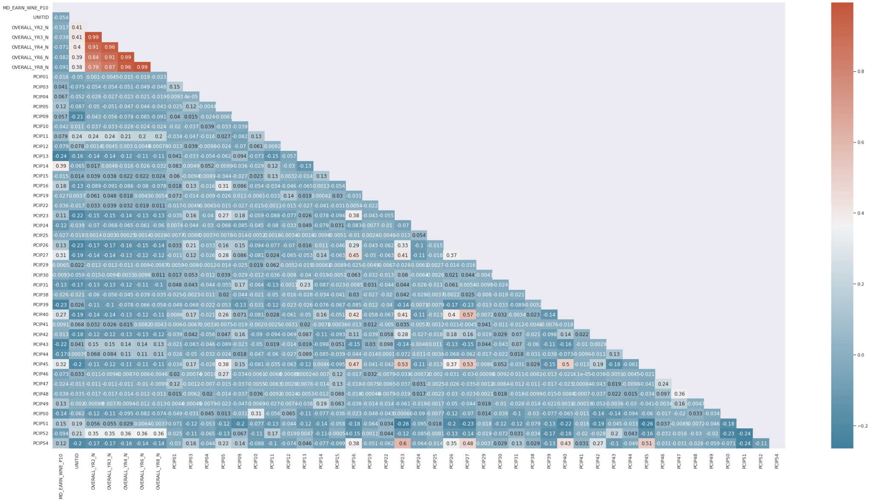
Exploratory Data Analysis
Notes:
After selecting the columns of interest or features, we wanted to see if there was any correlation to the main
PCIP16: Foreign Languages, Literatures, and Linguistics
PCIP23: English Language and Literature/Letters
PCIP26: Biological and Biomedical Sciences
PCIP27: Mathematics and Statistics
PCIP40: Physical Sciences
PCIP45: Social Sciences
PCIP54: History
PCIP52 0.19 = Percentage of degrees awarded in Business, Management, Marketing, And Related Support Services.
PCIP51 0.16 = Percentage of degrees awarded in Health Professions And Related Programs.
PCIP50 0.06 = Percentage of degrees awarded in Visual And Performing Arts.
PCIP42 0.06=Percentage of degrees awarded in Psychology.
PCIP26 0.05 = Percentage of degrees awarded in Biological And Biomedical Sciences.
PCIP45 0.05 = Percentage of degrees awarded in Social Sciences.
PCIP13 0.05= Percentage of degrees awarded in Education.

Slide 11
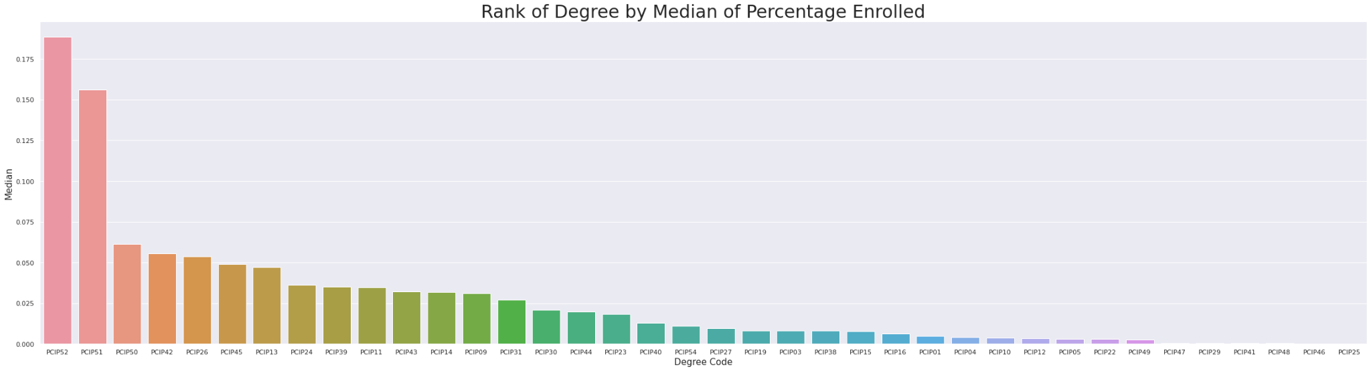
Exploratory Data Analysis
Top 5 degree programs by the median of students enrolled compared to total student body are:
PCIP52 - Percentage of degrees awarded in Business, Management, Marketing, And Related Support Services.
PCIP51 - Percentage of degrees awarded in Health Professions And Related Programs.
PCIP50 - Percentage of degrees awarded in Visual And Performing Arts.
PCIP42 - Percentage of degrees awarded in Psychology.
PCIP26 - Percentage of degrees awarded in Biological And Biomedical Sciences.
Notes:
PCIP52 0.19 = Percentage of degrees awarded in Business, Management, Marketing, And Related Support Services.
PCIP51 0.16 = Percentage of degrees awarded in Health Professions And Related Programs.
PCIP50 0.06 = Percentage of degrees awarded in Visual And Performing Arts.
PCIP42 0.06=Percentage of degrees awarded in Psychology.
PCIP26 0.05 = Percentage of degrees awarded in Biological And Biomedical Sciences.
PCIP45 0.05 = Percentage of degrees awarded in Social Sciences.
PCIP13 0.05= Percentage of degrees awarded in Education.

Slide 12
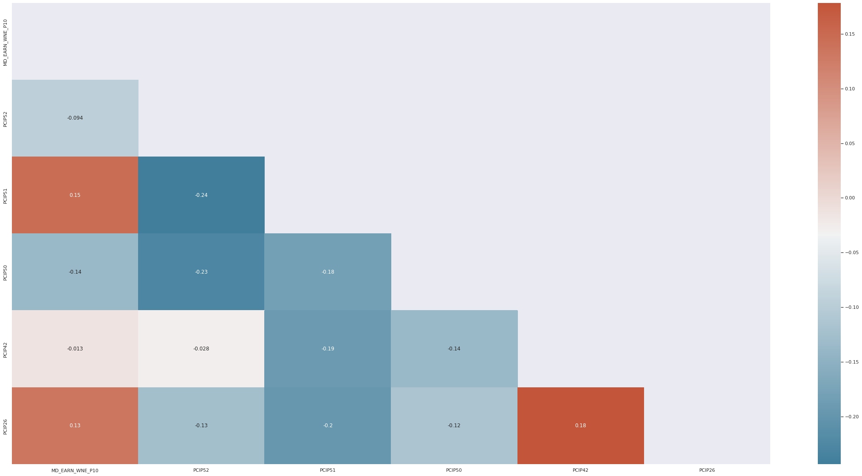
Exploratory Data Analysis
Correlation of top 5 Programs and Median Earning
PCIP52 - Percentage of degrees awarded in Business, Management, Marketing, And Related Support Services.
PCIP51 - Percentage of degrees awarded in Health Professions And Related Programs.
PCIP50 - Percentage of degrees awarded in Visual And Performing Arts.
PCIP42 - Percentage of degrees awarded in Psychology.
PCIP26 - Percentage of degrees awarded in Biological And Biomedical Sciences.
MD_EARN_WNE_P10 - Median earnings of students working and not enrolled 10 years after entry

Slide 13
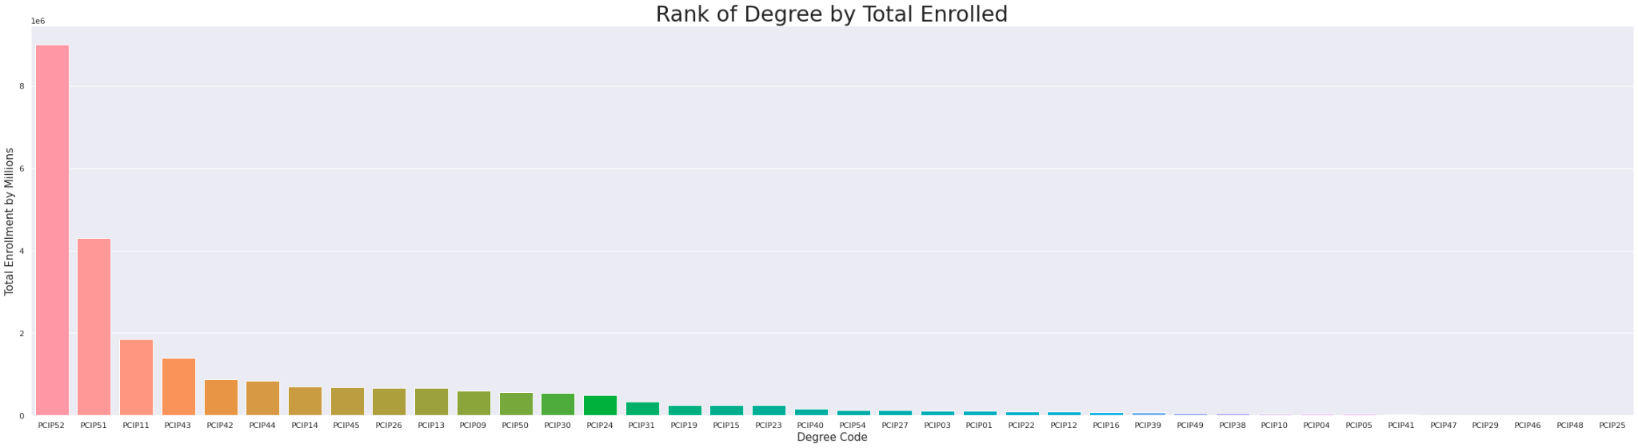
Exploratory Data Analysis
Top 5 degree programs by enrollment are:
PCIP52 - Total Enrollment for degrees awarded in Business, Management, Marketing, And Related Support Services.
PCIP51 - Total Enrollment for degrees awarded in Health Professions And Related Programs.
PCIP11 - Total Enrollment for degrees awarded in Computer And Information Sciences And Support Services.
PCIP43 - Total Enrollment for degrees awarded in Homeland Security, Law Enforcement, Firefighting And Related Protective Services.
PCIP42 - Total Enrollment for degrees awarded in Psychology.

Slide 14
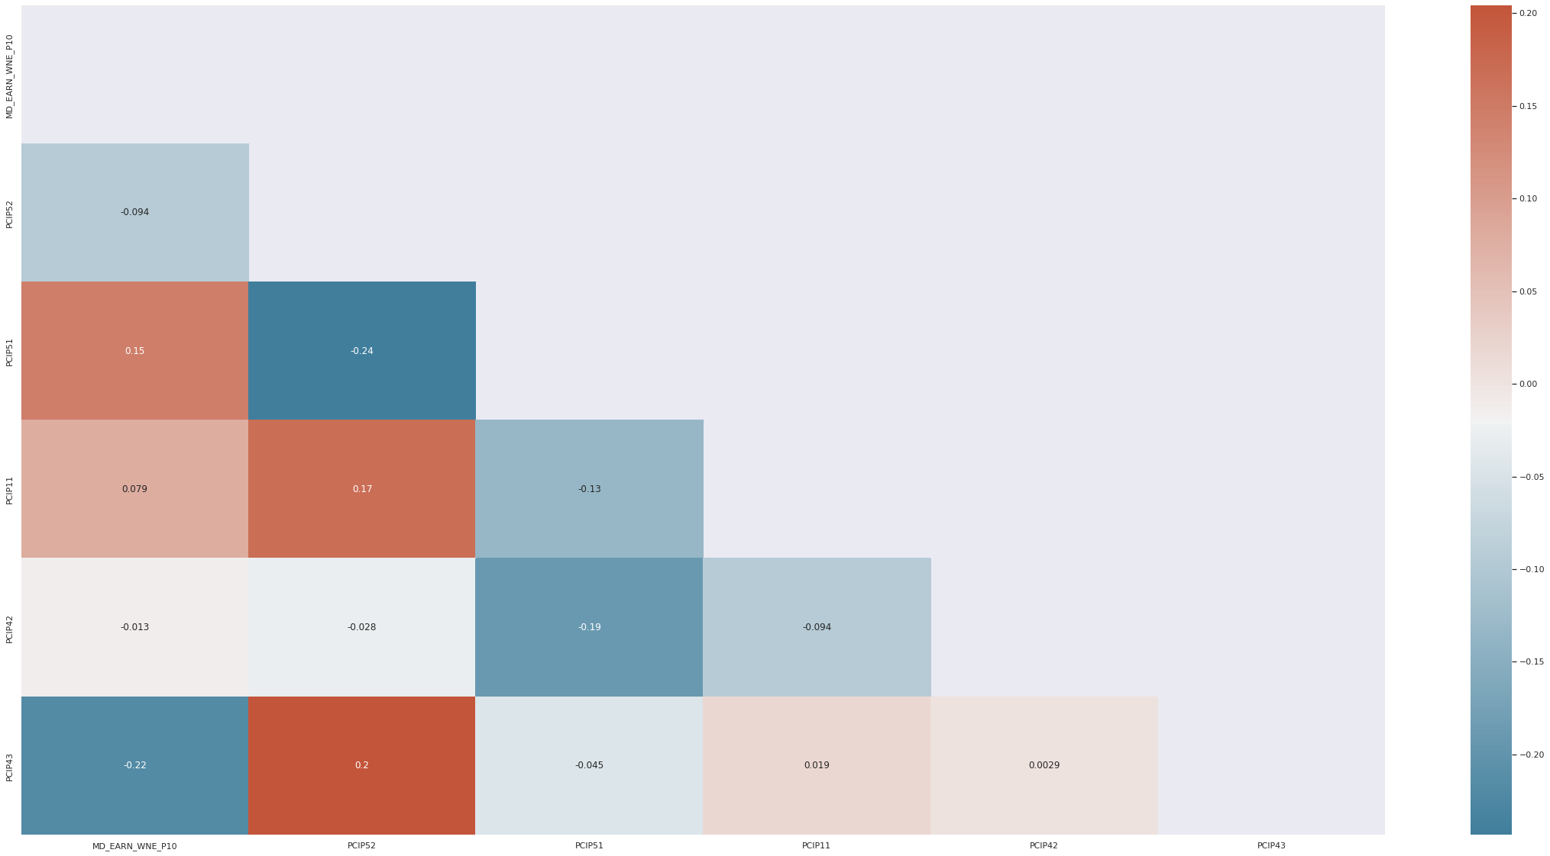
Exploratory Data Analysis
Correlation of top 5 programs and median earning
PCIP52 - Total Enrollment for degrees awarded in Business, Management, Marketing, And Related Support Services.
PCIP51 - Total Enrollment for degrees awarded in Health Professions And Related Programs.
PCIP11 - Total Enrollment for degrees awarded in Computer And Information Sciences And Support Services.
PCIP43 - Total Enrollment for degrees awarded in Homeland Security, Law Enforcement, Firefighting And Related Protective Services.
PCIP42 - Total Enrollment for degrees awarded in Psychology.
MD_EARN_WNE_P10 - Median earnings of students working and not enrolled 10 years after entry

Slide 15
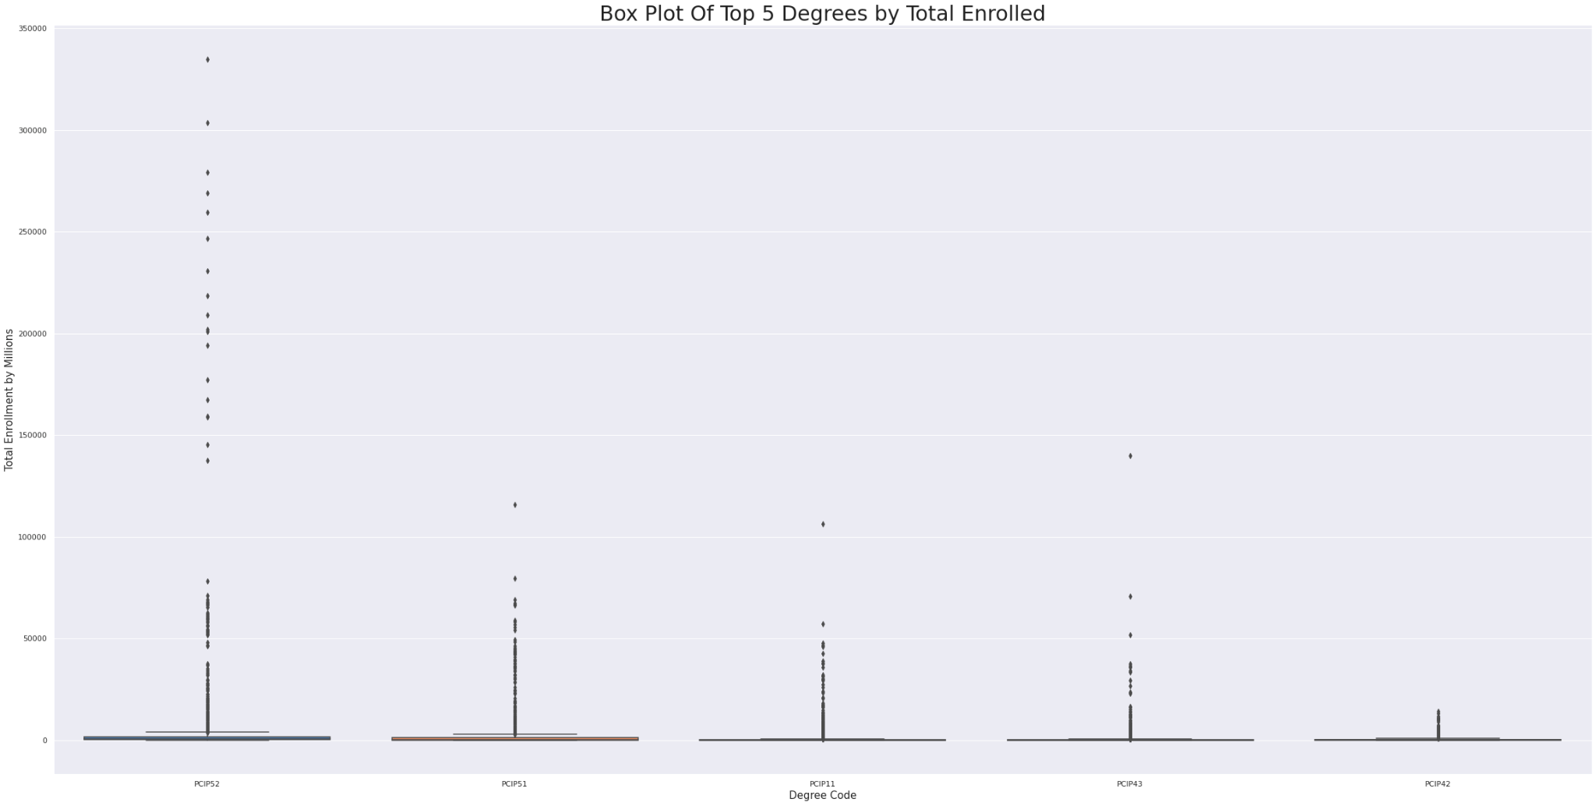
Exploratory Data Analysis
PCIP52 - Total Enrollment for degrees awarded in Business, Management, Marketing, And Related Support Services.
PCIP51 - Total Enrollment for degrees awarded in Health Professions And Related Programs.
PCIP11 - Total Enrollment for degrees awarded in Computer And Information Sciences And Support Services.
PCIP43 - Total Enrollment for degrees awarded in Homeland Security, Law Enforcement, Firefighting And Related Protective Services.
PCIP42 - Total Enrollment for degrees awarded in Psychology.
Notes:
The box plots shows the averages are actually very close and we happen to have some outliers that change the programs overall.

Slide 16
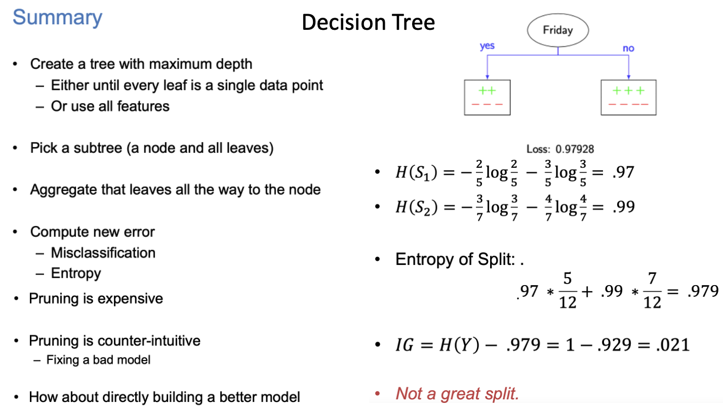

Slide 17
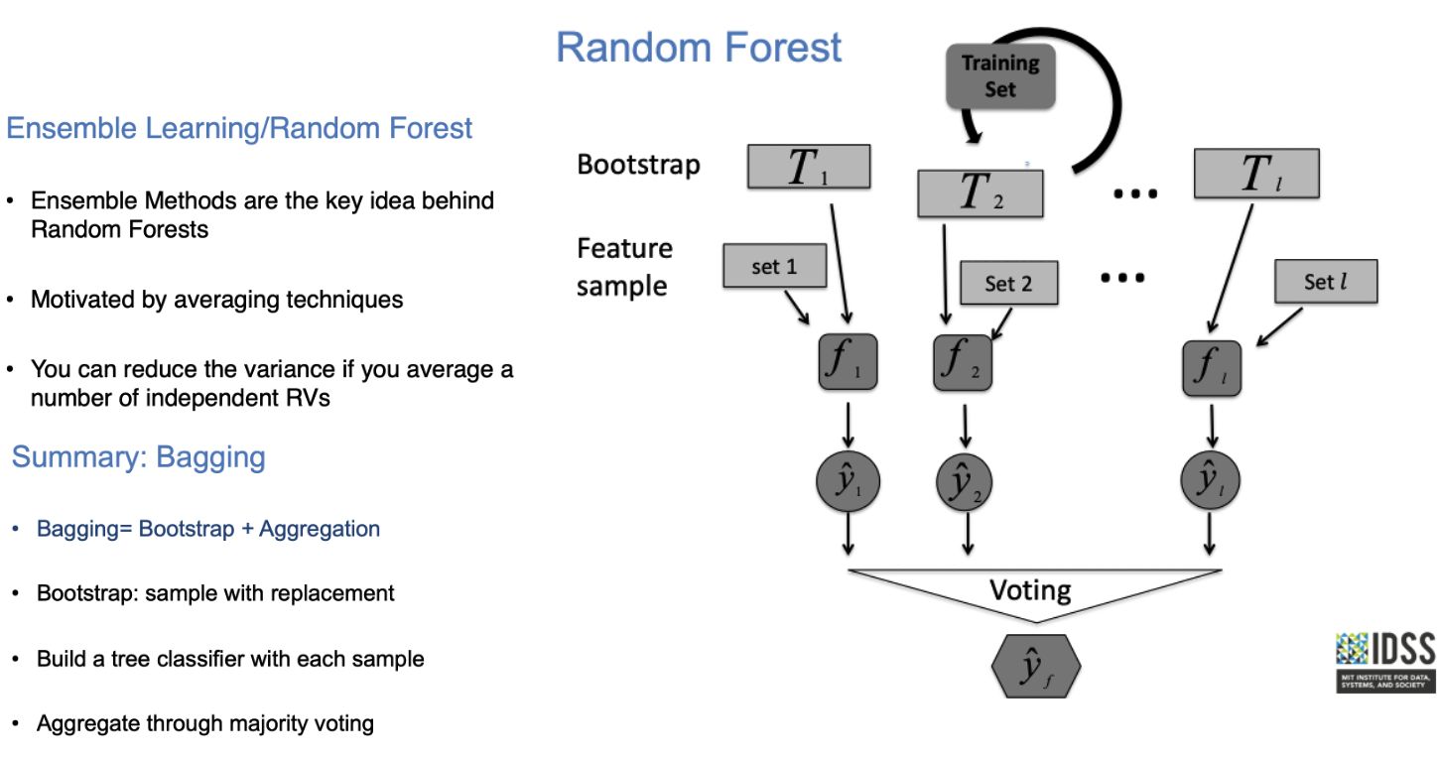

Slide 18
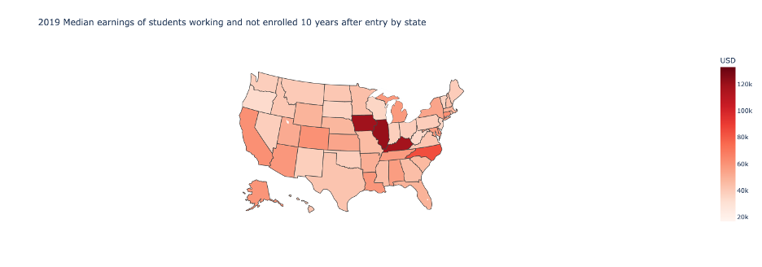
Students’ Median Earning by State

Slide 19
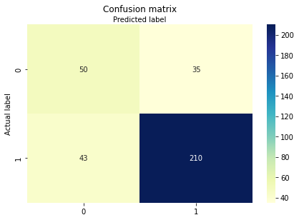
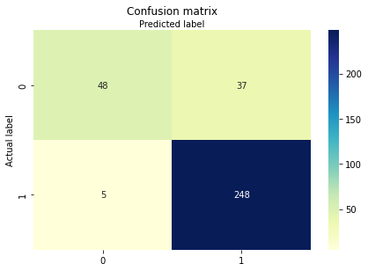
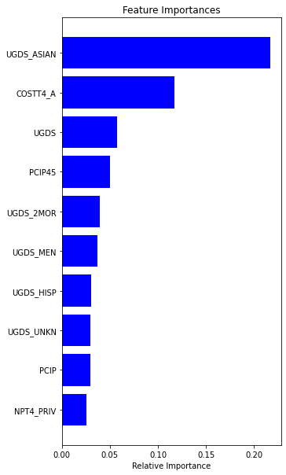
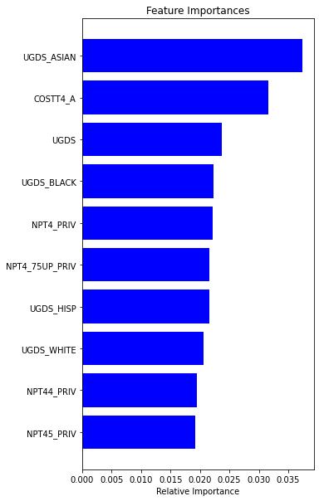
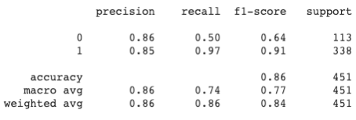
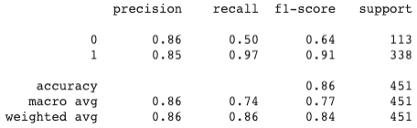
Models and Performance
Confusion Matrix and Top 10 Features from DT
Confusion Matrix and Top 10 Features from RF
Feature Engineering:
Categorical variables:
Group school level data by regions and impute missing values with the mode
Convert each categorical variable into dummy
Continuous variables:
Group data by school and year, and impute missing with the mean
Convert continuous variables into categorical ones by creating bins
Target (Binary) - MD_EARN_WNE_P10 (Median earnings of students working and not enrolled 10 years after entry)
1, if MD_EARN_WNE_P10> median
0, else
Random forest is more accurate than single decision trees, but it is not as comprehensible as decision trees.
Important features from both models include:
Average cost of attendance
Enrollment of degree-seeking students and diversity of students
Average net price of family income
Degree programs
Type of school
Classification Report for DT
Classification Report for RF
Notes:
DT:
UGDS_ASIAN: Total share of enrollment of undergraduate degree-seeking students who are Asian
COSTT4_A: Average cost of attendance
PCIP26: Percentage of degrees awarded in Biological And Biomedical Sciences.
PCIP39: Percentage of degrees awarded in Theology And Religious Vocations.
UGDS_NRA: Total share of enrollment of undergraduate degree-seeking students who are non-resident aliens
UGDS_MEN: Total share of enrollment of undergraduate degree-seeking students who are men
UGDS_WHITE: Total share of enrollment of undergraduate degree-seeking students who are white
UGDS_ASIAN: Total share of enrollment of undergraduate degree-seeking students who are Asian
NPT42_PRIV: Average net price for $30,001-$48,000 family income (private for-profit and nonprofit institutions)
RF:
UGDS_ASIAN: Total share of enrollment of undergraduate degree-seeking students who are Asian
COSTT4_A: Average cost of attendance
NPT4_PRIV: Average net price for Title IV institutions (private for-profit and nonprofit institutions)
NPT4_75UP_PRIV: Average net price for $75,000+ family income (private for-profit and nonprofit institutions)
UGDS_BLACK: Total share of enrollment of undergraduate degree-seeking students who are black
UGDS_WHITE: Total share of enrollment of undergraduate degree-seeking students who are white
UGDS_HISP: Total share of enrollment of undergraduate degree-seeking students who are Hispanic
UGDS: Enrollment of undergraduate certificate/degree-seeking students
NPT44_PRIV:Average net price for $75,001-$110,000 family income (private for-profit and nonprofit institutions)

Slide 20
References
U.S Department of Education (2020). College Scorecard Institution-Level Data [Data Files]. Available from College Scorecard https://collegescorecard.ed.gov/data/

